Slide 1



Face Mask
Detection
Owen Attard
xattaro00

Slide 2


Overview
Pipeline
Models
Evaluation
Inference
Difficulties

Slide 3






Pipeline
Pre-Processing
Training
Evaluattion
Inference

Slide 4


Pipeline
Pre-Processing
Training
Evaluattion
Inference
Dataset

Slide 5

Pipeline
Pre-Processing
Training
Evaluattion
Inference
Dataset
Labeling

Slide 6

Pipeline
Pre-Processing
Training
Evaluattion
Inference
Dataset
Labeling
Splitting

Slide 7
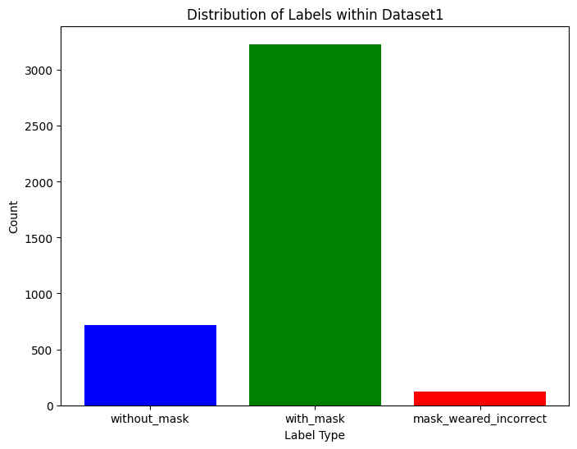
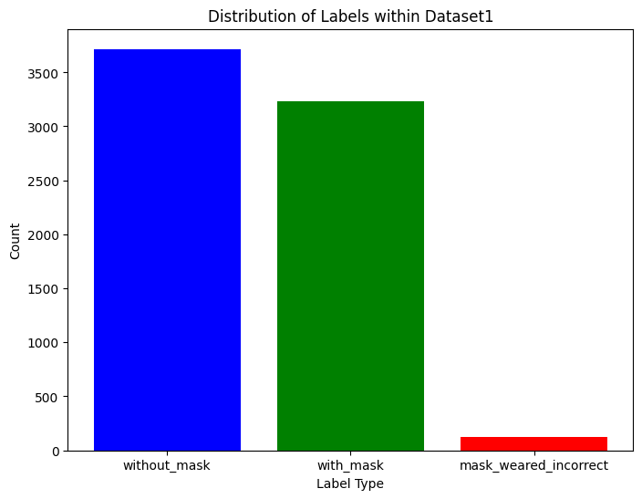
Datasets

Slide 8
Pipeline
Pre-Processing
Training
Evaluattion
Inference

Slide 9
Pipeline
Pre-Processing
Training
Evaluattion
Inference

Slide 10
Pipeline
Pre-Processing
Training
Evaluattion
Inference

Slide 11

Models
1.
2.
YOLOv11 nano
Faster R-CNN R-50-FPN 3x

Slide 12
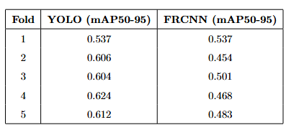
Evaluation

Slide 13
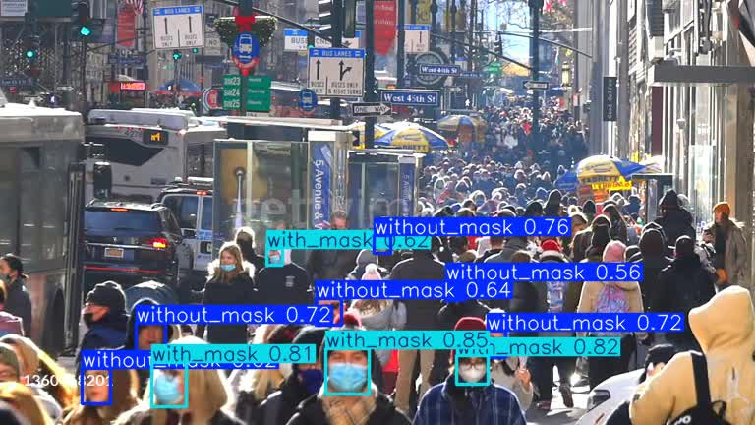
Inference Video

Slide 14
Limitations
&
Considerations
Computational Resources
Data imbalance

Slide 15
The end.
Thank you for listening!

